Slide 1
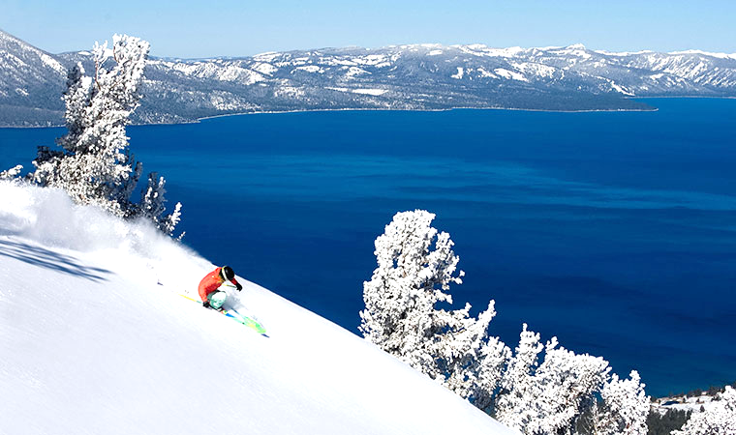
Comparison of Ski Resort Towns in the Western U.S.
--and--
Real Estate Values

Slide 2
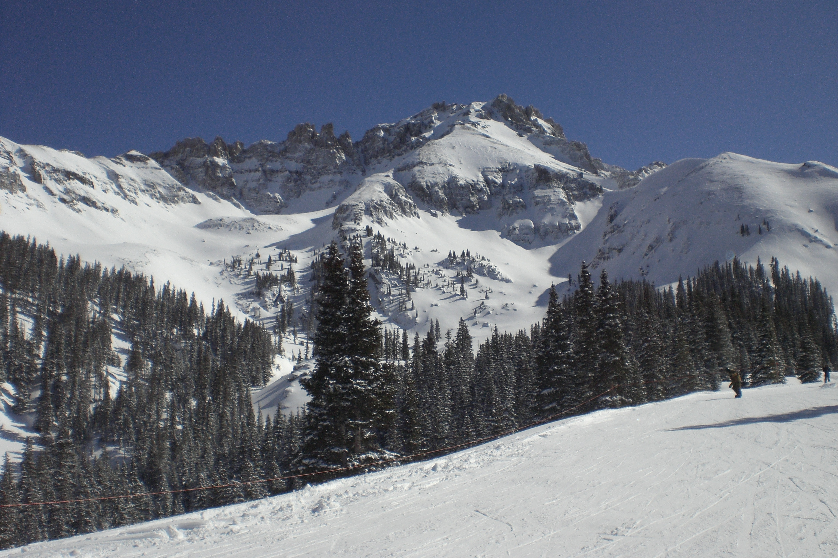
Buyers looking to buy a vacation or retirement home need to take a disciplined data driven approach to selecting a destination
Subjective factors have their place, but a buyer relying solely of “feels” may find himself disappointed in the long run.
This study takes a look at ski resort towns in the western U.S. and rates them on objective data compared to real estate prices.

Slide 3

Data is grouped into 3 broad categories for each town
Variety of things to do when not skiing based on number of venues
Restaurants, Shopping Venues, Recreation Venues, Entertainment Venues and “Other”
2. Quality of Life indicators
Average Sunny Days per Year, Average Temperature in January, Cost of Living Index, Air Quality Index, Crime Rate, and School Quality Rating
3. Indicators of the Varity and Quality of the Skiing
Immediately Skiable Acreage, Easily Commutable Skiable Acreage, Vertical Drop, Number of Lifts,
Lifts per Acre, and Average Annual Snowfall
Photo: Jackson Hole

Slide 4

Normalized Scores for Number and Type of Venue
Park City leads the venues category with the most restaurants, most stores and most entertainment venues. Incline Village has the most non-skiing recreation opportunities and Aspen leads the “Other” category.
Photo: Park City at night

Slide 5
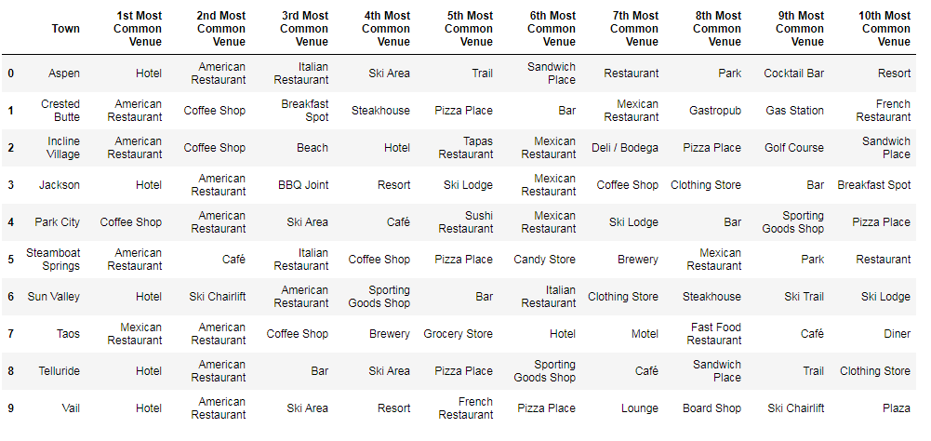

Most Common Venues in Each Town
Main Street , Telluride CO

Slide 6

Normalized Scores for Quality of Life Indicators
Incline Village had the highest score on the strength of having the lowest crime rate. Ironically, Sun Valley has the least amount of sunshine, but the best air quality and the second lowest crime rate. Taos has the most sunshine and lowest cost of living but the worst crime. Crested Butte has the best schools but the coldest winter temperatures. Park City has the warmest winter temperatures but the highest cost of living and the worst air quality. Incline Village is the only town that has the highest score in one category that doesn’t have the lowest score in another category.
Photo: Incline Village at night

Slide 7

Normalized Scores for Skiing Quality and Quantity
Incline Village has the top score for shear number of slopes within easy commuting distance of the town even though the skiable acres immediately adjacent to the town are relatively few. Park City has the most ski in/out acreage but a very low ratio of lifts per acre indicates the possibility of long lift lines. Telluride has the biggest Vertical and Vail has the biggest average annual snowfall of the towns studied.

Slide 8

Total Score Is the Sum of the 3 Categories
Incline Village has the best overall score followed by Park City and Sun Valley

Slide 9

Incline Village has the most consistent scores among the 3 categories

Slide 10
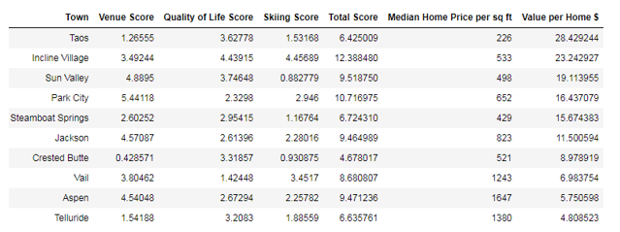

Divide the Total Score by Median Home Price per Sq. Ft. to derive an indicator of relative “bang for the buck”
Taos represents the most value based on its overall score and low
real estate prices
Taos

Slide 11
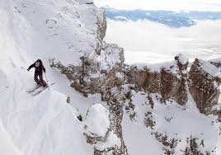
Why is Taos real estate so relatively cheap? Before buying one should investigate why prices have not increased in the last decade while most other ski towns have experienced healthy price appreciation.

Slide 12

Conclusion
Given the features of the data that were examined and the weights assigned to them, Taos, New Mexico gives the most “bang for the buck” of the 10 ski towns that were considered. Without regard to housing costs, Incline Village, Nevada appears to be the overall best town and is second behind Taos in value for the dollar.
Before purchasing a home in Taos, one should investigate why real estate values have been flat there for years while real estate in every other ski town has appreciated significantly.
Incline Village given that it finished first overall and second in value may actually be a better investment than Taos as real estate values in Incline are on a sustained upward trajectory, while Taos only finished 9th out of 10 towns in over score all score and appears to have a moribund real estate market.
Finally, while a real estate buying decision ought to be fully informed by the available data, subjective factors are also important and should not be completely discounted. This study does not attempt to capture such factors as they could be different for every person.

